Slide 1
Plant Life Cycle

Slide 2
What is a Life Cycle ?
All living things have a life cycle.
A life cycle is the stages of development and growth living things go through.

Slide 3
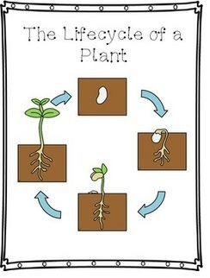
The Plant Life cycle
Has 4 stages:
Seed
Sprout
Small plant
Adult Plant

Slide 4
The process
The plant life cycle begins with:
The seed being planted into soil and with water and sunlight it will being to grow into a sprout.
The sprout will then grow roots that go deep into the ground and stretch through the soil.

Slide 5
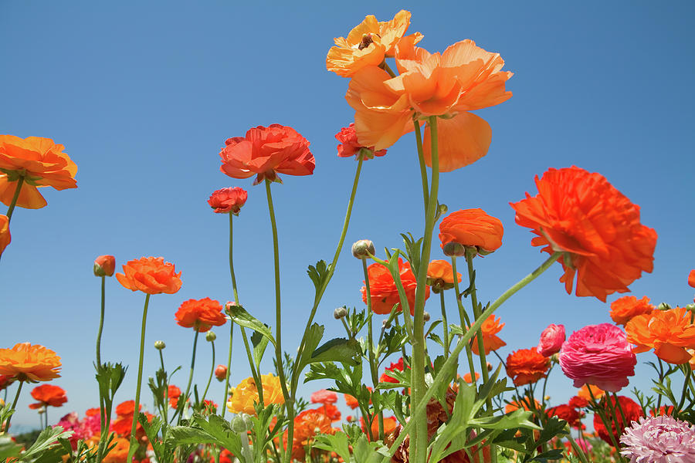
Continued
The plant will start to grow leaves towards the sun.
The sun helps the plant produce food to become a small plant.
Once it becomes an adult plant, you’ll see flowers start to bloom.

