Slide 1
Curriculum Night 2021

Slide 2
Welcome Everyone !!
Tonight, we’ll be going over:
Classroom expectations
Classroom schedule
I can standards
Homework
How to context me
Questions

Slide 3
Classroom Expectations
Listen when the teacher or your friends are speaking
Listen and follow directions
Respects others
Be kind
Keep hands and feet to yourself
Raise your hand and wait to be called on
Clean up after yourself and keep your area clean

Slide 4
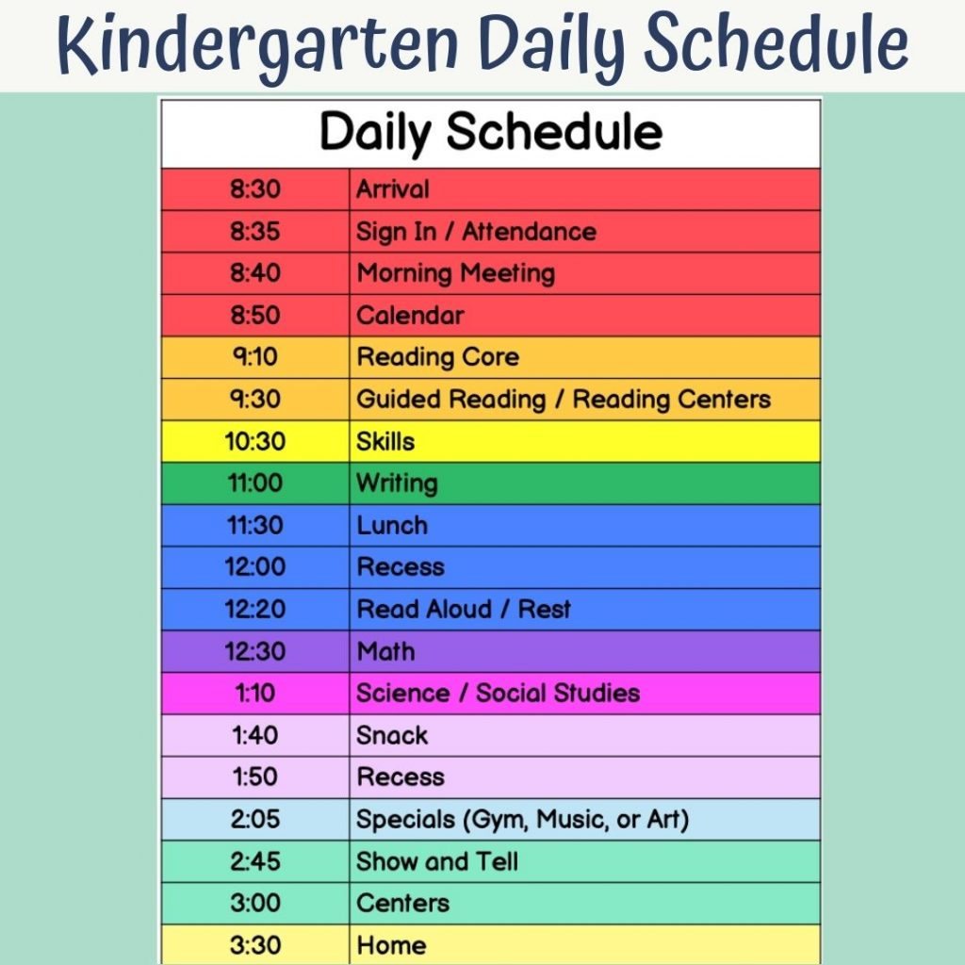
Classroom Schedule

Slide 5
I Can Standards
Reading | Math | Language
I can… say the sound each consonant makes. | I can… write numbers. | I can… write CAPITAL and lowercase letters.
I can… be a word detective and see how words are different by their letters. | I can… identify which group has more and which has less. | I can… add /s/ or/es/ to make plural nouns.

Slide 6
Homework
The students have a week to complete the following:
A spelling word worksheet
Read at least 20 minutes a night and log it
weekly math packet
All the work will be due on Fridays

Slide 7
Contact Information
The best way to reach me will be my Email: MelissaMackenzie@.
You can always contact the school to reach me.
You can also send notes or write letters and put them in your child’s folder and I will send a note/letter back.

Slide 8
Any Questions
Can’t wait to have a wonderful school year !

